Slide 1
Silverlight and WPF
Mathias Andersson

Slide 2
Agenda
WPF and Silverlight, same parents…
What can you do with WPF/Silverlight?
Design and code, separate paths, same goal!
Demo

Slide 3
Why WPF?
The GDI & USER subsystems were introduced in Windows 1.0 in 1985
OpenGL – Early 90s
DirectX – 1995
Goal: Overcome the limits of GDI+ & USER with the productivity of Windows Forms

Slide 4
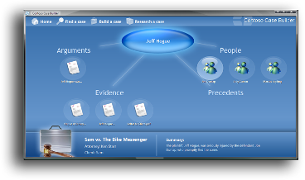
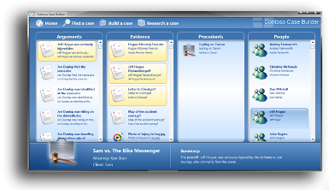
WPF Vision
Unified approach to UI, Documents, and Media
Integration as part of development and experience
Integrated, vector-based composition engine
Utilizing the power of the PC throughout the graphics stack
Declarative programming
Bringing designers directly into application development
Ease of deployment
Allowing administrators to deploy and manage applications securely

Slide 5
WPF FAQ
Does WPF enable me to do something I couldn’t have done before?
No. Unless you factor in time & money…
Is DirectX dead?
No. It is more applicable to advanced 3D developers writing hard-core “twitch” games.
Are Winforms dead?
No. …but it will not be advanced; the last version was 2.0 in .NET 2005.
WPF / Winforms Bastardization
Windows 98 Supports WinForms
Does WPF run better on Vista than on XP?
Yes.
3D objects only get anti-aliasing on Windows Vista or Later
Non-rectangular windows only get hardware acceleration on Vista.
Vista has a driver model that helps with resource contention

Slide 6
WPF – how does it work?
Built on Top of Direct 3D
Converted to 3D triangles, textures and other Direct3D objects & then rendered by hardware
Benefits of hardware acceleration & performance due to work being off-loaded to GPUs (unlike GDI based systems)
Ensures the maximum benefit of new hardware and drivers
Software rendering pipeline as fallback

Slide 7



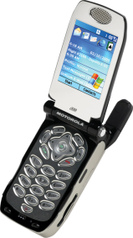
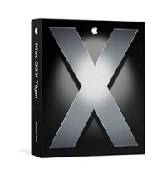
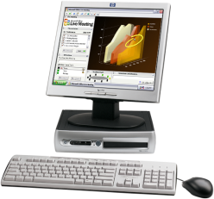
Silverlight… “WPF Light”
Lightweight WPF runtime
Interactive experiences for devices, PC, & Mac platforms (and others…)
Strict subset of Windows Presentation Foundation
Lightweight download
Programming model uses XAML + JScript
Access to WPF tooling
WPF-based Tools
<XAML>
<Button Width="100px"> OK
<Button.Background>
LightBlue
</Button.Background>
</Button>
</XAML>
Notes:
7
©2005 Microsoft Corporation. All rights reserved.
This presentation is for informational purposes only. Microsoft makes no warranties, express or implied, in this summary.

Slide 8
What the heck is XAML?
Separates the front-end from the back-end
Simple declarative programming language suitable for constructing and initializing .NET Objects
Usually the most concise way to represent user interfaces (or other hierarchies of objects)
Doesn’t need a compile to render
The language that almost all WPF related tools emit

Slide 9
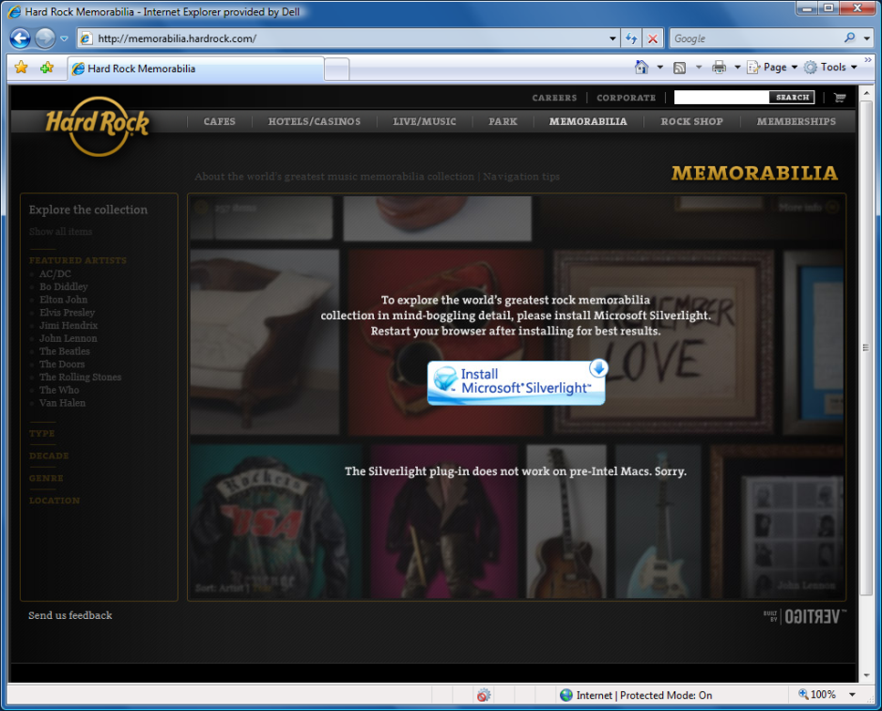
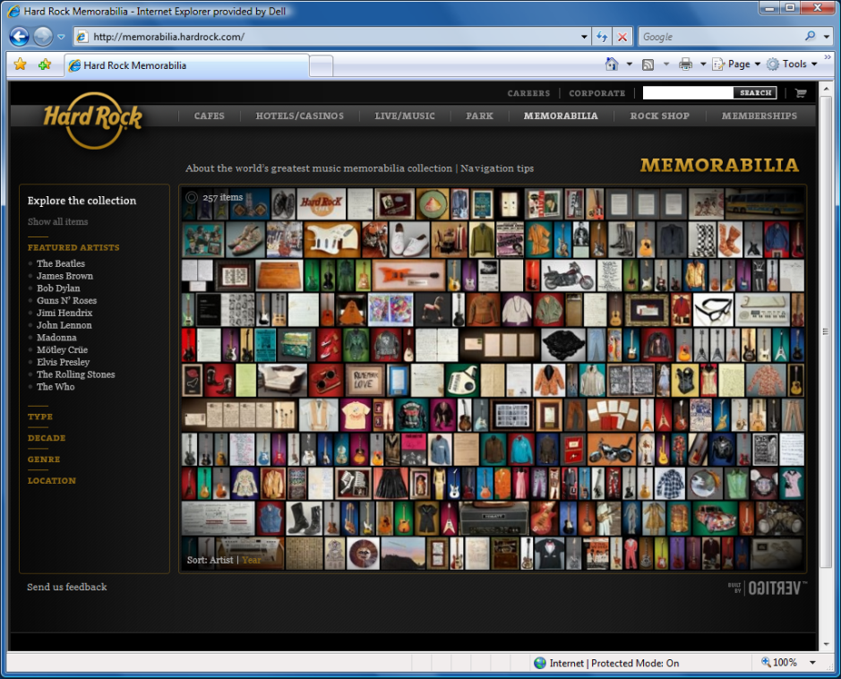
Silverlight install experience
Before Install
After Install

Slide 10
Silverlight - Hello World
Create Tree
Draw
Download
Load CLR
Measure
Arrange
Parse
Create
Text stack
Present
Create Application
Layout

Slide 11
Expression Blend Topics
Things in Blend that are different but not totally unfamiliar to Visual Studio developers
Toolbox – different construction
Document outline (much more important in WPF)
Things in Blend that have no counterparts in Visual Studio
Animation/Trigger editor
Resource manager
Style manager
Template editors (with import of data structures)

Slide 12
The Role Of Visual Studio For WPF/Silverlight Projects
Anything related to coding or debugging
Anything related to integration with other technologies
For example, automatic hosting of WCF services
Things Visual Studio does better than Blend
Grid Row and Column definitions
Intellisense in XAML editing

Slide 13
UI Customization
Microsoft Silverlight is designed for UI flexibility
Customize the look of an application without changing it’s behavior
Two levels of customization:
Styling: Small visual changes on an element (font, background color, etc.)
Skinning: Replacing an element’s entire visual tree

Slide 14
Constructing A Data Template
Element type is DataTemplate
Root element of DataTemplate usually some type of Panel
Panel holds elements that display properties of data item
<DataTemplate>
<StackPanel>
<Label Content="{Binding Path=FirstName}" />
<Label Content="{Binding Path=LastName}" />
<Label Content="{Binding Path=BirthDate}" />
</StackPanel>
</DataTemplate>

Slide 15
demo

Slide 16

WPF Resources
WPF Unleashed, Adam Nathan, Sams Publishing, www.adamnathan.net/wpf
Programming WPF 2nd Edition, Chris Sells and Ian Griffiths, O’Reilly http://www.amazon.com/Programming-WPF-Chris-Sells/dp/0596510373
Essential WPF, Chris Anderson, Addison Wesley, http://www.simplegeek.com/book
Application = Code + Markup, Charles Petzold, MS Press, http://www.charlespetzold.com/wpf.
.NET Rocks! TV: http://dnrtv.com (episodes 56,59, 101)
Data Binding with Windows Forms 2.0, Brian Noyes, Addison Wesley http://www.softinsight.com/databindingbook

Slide 17
Silverlight Resources
http://scorbs.com/work (Karen Corby, Silverlight Program Manager)
http://hamidm.com (Hamid Mahmood, Silverlight Program Manager)
http://blogs.msdn.com/seema (Seema Ramchandani, Silverlight Performance)
http://letstakeovertheworld.com/blog (Larry Olson, Silverlight Program Manager)
http://blogs.msdn.com/markrideout (Mark Rideout, Silverlight Program Manager)

Slide 19
Dispatch System Basics
WPF has two main threads
UI thread (like Windows Forms)
Rendering thread (renders in background)
Operations on the UI thread are handled through a Dispatcher object
Operations (delegates) sent to the Dispatcher can have priority set
Examples: ApplicationIdle, ContextIdle
If priority is ContextIdle, the operation will wait until nothing else is going on to execute

Slide 20
Value Conversion
Converter property on Binding, parameter optional
Class that implements IValueConverter
Should put ValueConversion attribute on class

Slide 21
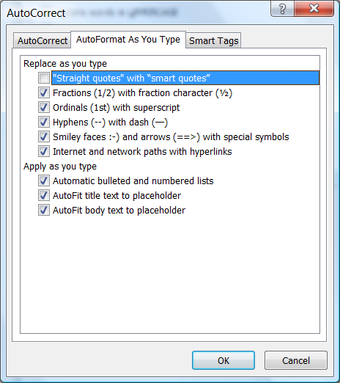
Slide for Showing Software Code
Use this layout to show software code
The font is Consolas, a monospace font
The slide doesn’t use bullets but levels can be indented using the “Increase List Level” icon on the Home menu
To use straight quotes " instead of smart quotes ”, do this:
Click on the Office Button in the upper left corner
At the bottom of the menu, choose PowerPoint Options
From the left pane, select Proofing
Click on the AutoCorrect Options button
Select the AutoFormat As You Type tab, and deselect “Straight quotes” with “smart quotes”. Then Click OK.

